Slide 1

Text summarization
YANGYUE Wang

Slide 2
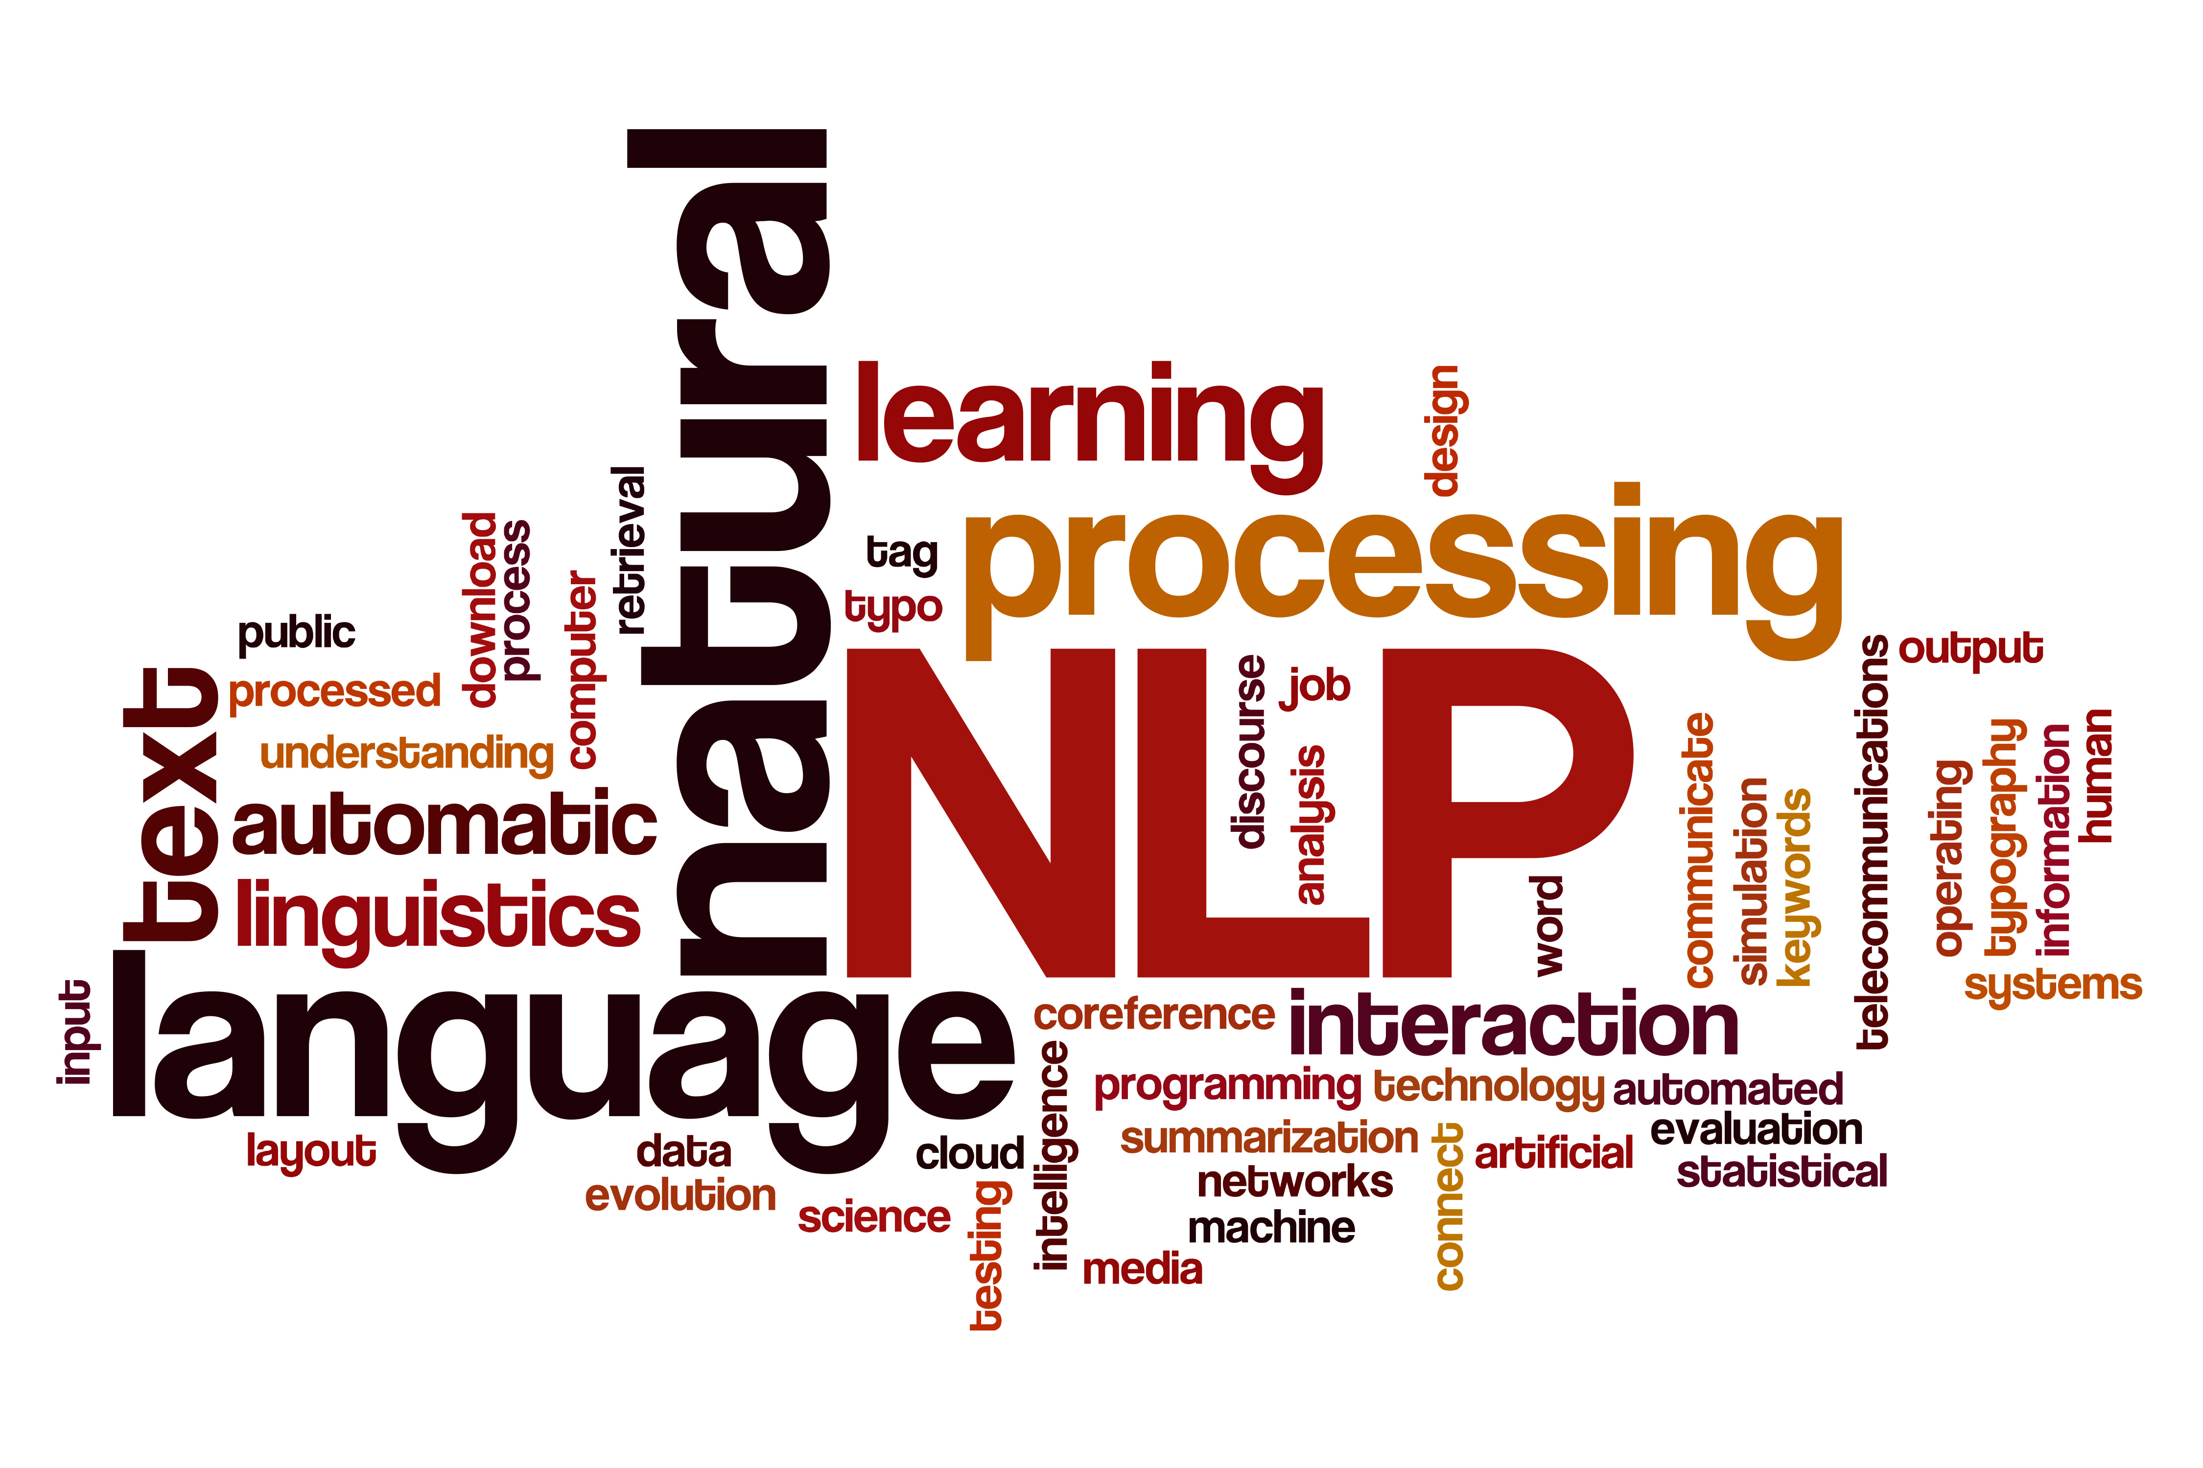
Sections
Summarization
Word Cloud Visualization
KMeans Clustering Sentences

Slide 3
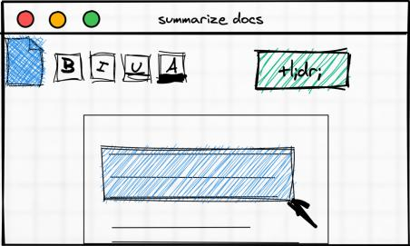
Summarization preprocessing
Remove HTML tags
Remove extra whitespaces
Convert accented characters to ASCII characters
Expand contractions
Remove special characters
Lowercase all texts
Remove numbers
Remove stop words
Lemmatization

Slide 4
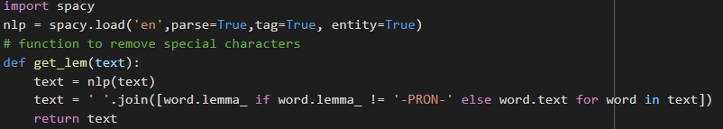

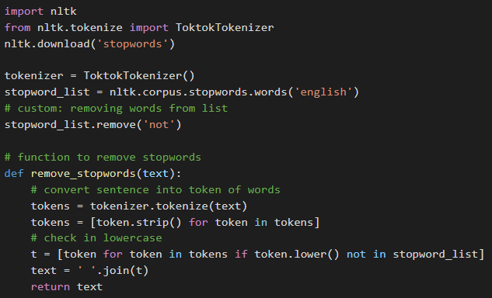
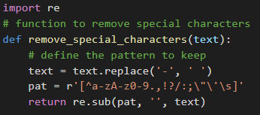
Summarization preprocessing
Lemmatization
Remove Contractions
Remove Stop words
Remove Special Characters

Slide 5
Summarization
Step 1 - Read text and tokenize
Step 2 - Generate similarity matrix across sentences
Step 3 - Rank sentences in similarity matrix
Step 4 - Sort the rank and pick top sentences
Step 5 - Output the summarize text

Slide 6
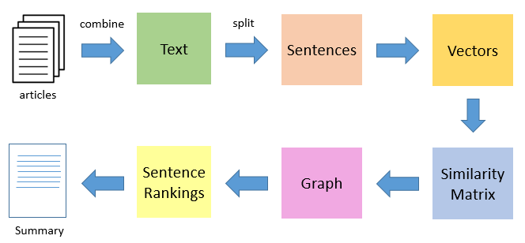
Summarization algorithm
[1] https://www.analyticsvidhya.com/blog/2018/11/introduction-text-summarization-textrank-python/

Slide 7
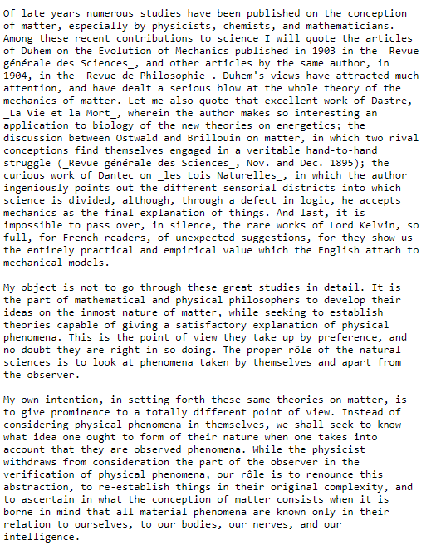

Summarization
https://www.gutenberg.org/

Slide 8
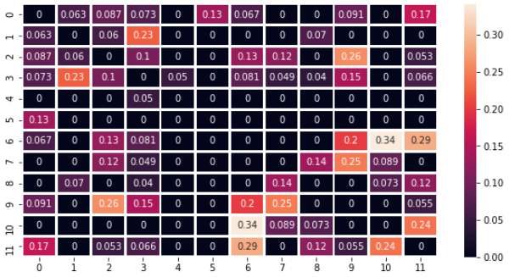
Similarity Matrix

Slide 9
Summarization Result
it be the part of mathematical and physical philosopher to develop their idea on the inmost nature of matter while seek to establish theory capable of give a satisfactory explanation of physical phenomenon. my own intention in set forth these same theory on matter be to give prominence to a totally different point of view. while the physicist withdraw from consideration the part of the observer in the verification of physical phenomenon our role be to renounce this abstraction to re establish thing in their original complexity and to ascertain in what the conception of matter consist when it be bear in mind that all material phenomenon be know only in their relation to ourselves to our body our nerve and our intelligence

Slide 10
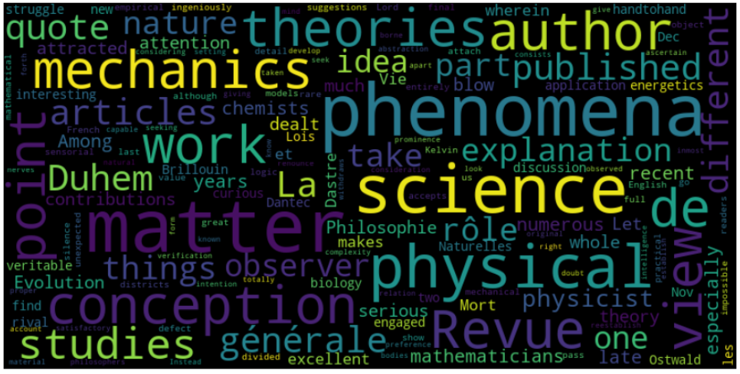
Word Cloud

Slide 11
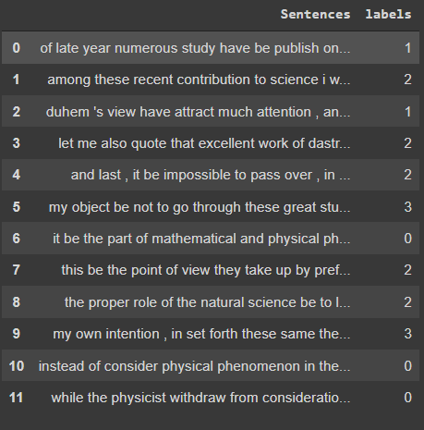
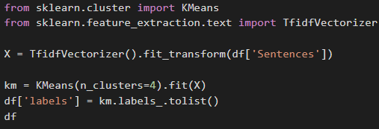
Kmeans Clustering

Slide 12
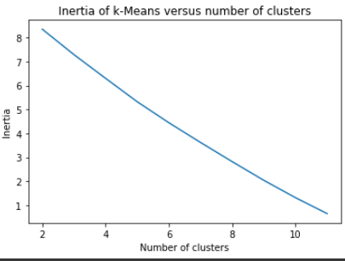
Elbow Method

Slide 13

Takeaways
Use abstractive instead of extractive summarization
Better preprocessing
De-lemmatize the summarized text
Speed up the algorithm for large text
Better similarity matrix algorithm

